Slide 1
Country Update - Brazil
17th April 2018
Rafael Diniz
DRM Country Representative

Slide 2
Since early 2017...
- Low power HF transmissions from EBC Rodeador Park (of Antennas)
- RRI signal to South America
- Workshop in University of Brasília (UnB)
- DRM low power transmission system in UnB lab for experimentation and demonstration
- MCTIC’s project for HF DRM transmission from EBC Rodeador Park

Slide 3
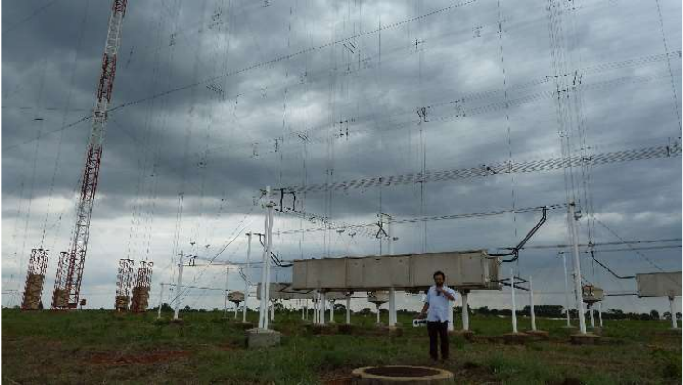
Low power HF transmissions from EBC Rodeador Park (of Antennas)

Slide 4
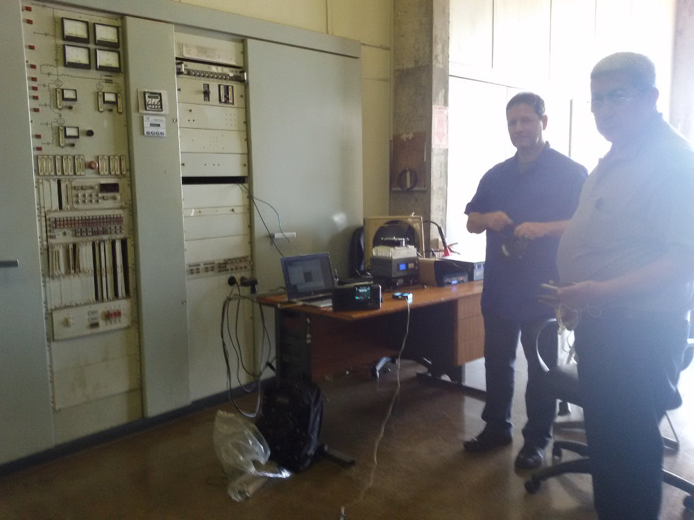
DRM HF transmissions
Notes:
<number>

Slide 5
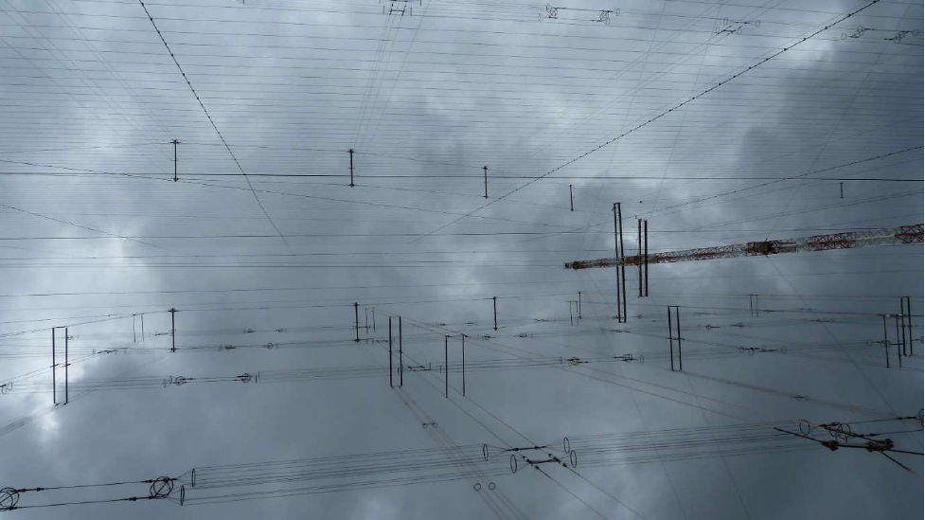
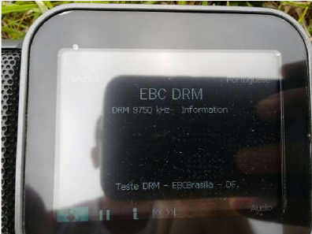
DRM HF transmissions
Notes:
<number>

Slide 6
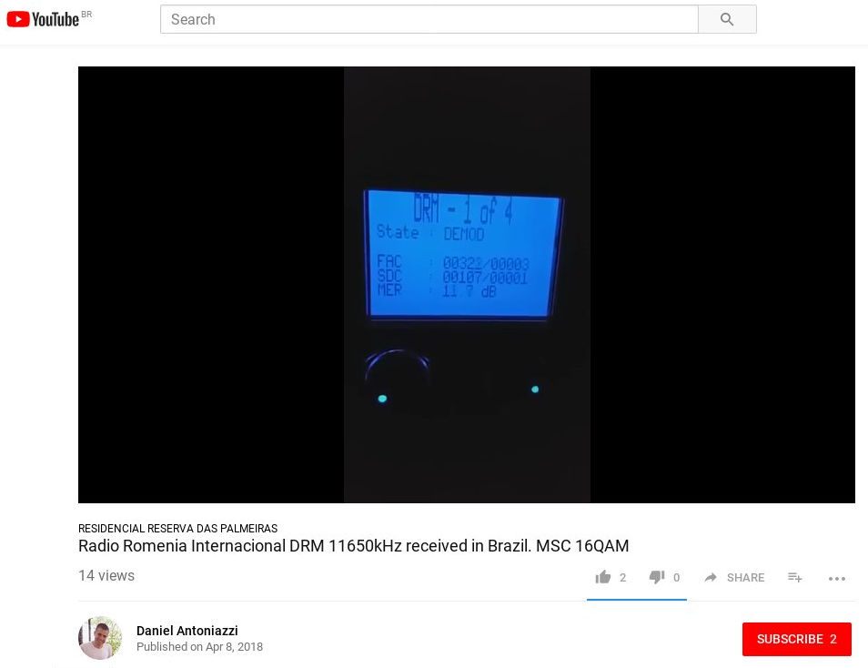
RRI to South America in Spanish!
Notes:
<number>

Slide 7
Conference at University of Brasília – ESC IV
13th-14th November 2017
DRM workshop - demonstration on 26MHz band, many configurations
Avion and Gospell receivers

Slide 8
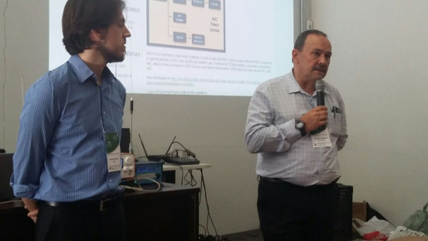
Conference at University of Brasília
Conferência Internacional Espectro, Sociedade e Comunicação IV

Slide 9
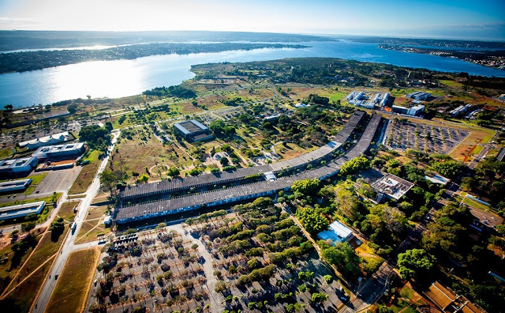
Antennas Laboratory in University of Brasília with DRM equipment

Slide 10
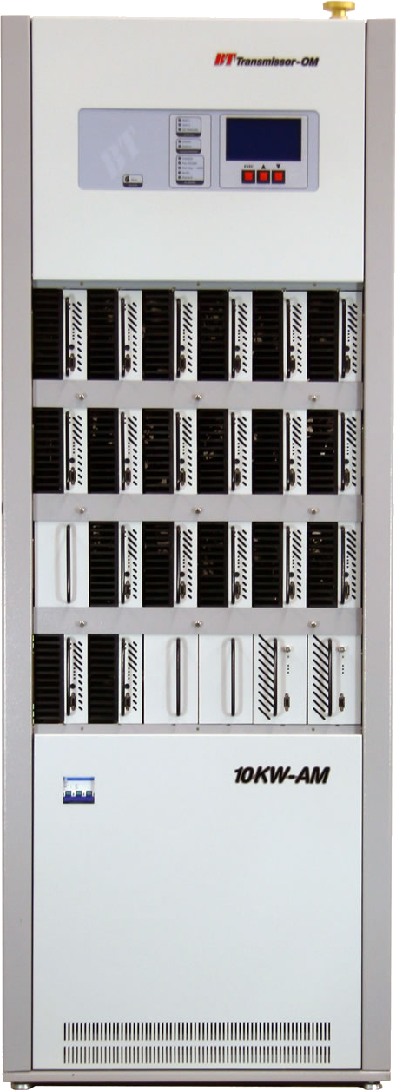
MCTIC’s project for HF DRM transmission from EBC’s Rodeador Park
Ministry of Science, Technology, Innovations and Communications:
Soon there will be a HF DRM signal on air from EBC tx site

Slide 11
Thanks!
Rafael Diniz

